Slide 1
IAM (Identity & Access Management)
AWS Identity and Access Management (IAM) is a web service that helps you securely control access to AWS resources.
You use IAM to control who is authenticated (signed in) and authorized (has permissions) to use resources
When you first create an AWS account, you begin with a single sign-in identity that has complete access to all AWS services and resources in the account.
This identity is called the AWS account root user and is accessed by signing in with the email address and password that you used to create the account.
You are limited to 5000 IAM user per AWS account & maximum 10 users can be added at a time.
Maximum 300 groups can be created per AWS account.
You are limited to 1000 IAM role under AWS account.
You can add 10 managed policies to user, role or group.
An IAM user can be member of 10 group.
We can assign two access key to an IAM user.

Slide 2
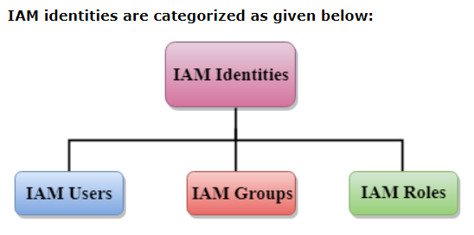
IAM Identities
It is created to provide authentication for people and process in AWS account.

Slide 3
IAM Users
An IAM User is an entity created in AWS that provides a way to interact with AWS resources.
The main purpose of IAM Users is that they can sign in to the AWS Management Console and can make requests to the AWS services.
The newly created IAM users have no password and no access key.
> If a user wants to use the AWS resources using the AWS Management Console, you need to create the user password.
> If a user wants to interact using the AWS programmatically (using the CLI), you need to create the access key for that user.
The newly created IAM Users do not have permissions, i.e., they are not authorized to access the AWS resources.
Each IAM User is associated with one and only one AWS account.
The security of the user's credentials can be enhanced by using the feature, i.e., Multi-Factor Authentication.

Slide 4
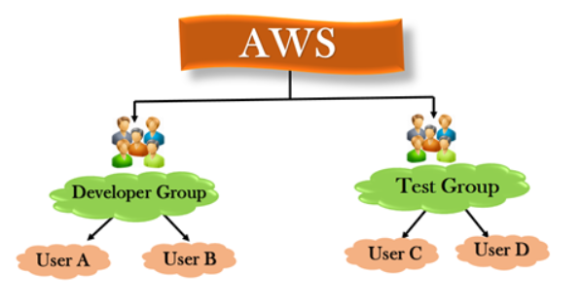
IAM Groups
A group is a collection of users and a user can also belong to multiple groups.
Groups cannot be nested, i.e. a group cannot contain another group.
No default group that automatically includes the users in AWS account. If you want a group, create a group first and then add the users in that group.
5 users can be created at a time

Slide 5
IAM Role
A role is a set of permissions that grant access to actions and resources in AWS. These permissions are attached to the role, not to an IAM User or a group.
An IAM User can use a role in the same AWS account or a different account.
Role is also an AWS identity with permission policies that determine what the identity can and cannot do in AWS.
A role is not uniquely associated with a single person; it can be used by anyone who needs it.
A role does not have long term security credential, i.e., password or security key. Instead, if the user uses a role, temporarily security credentials are created and provided to the user.
You can use the roles to delegate access to users, applications or services that generally do not have access to your AWS resources.
It can be used to grant access to the AWS resources which have identities outside of AWS.
It can be used when you want to grant the users to access the AWS resources in your or in another AWS account.

Slide 6
Lab1 : How to create IAM user and assign policies.
Enable dashboard options (security status).
Create user (user1), login with user1 & try to create EC2.
Now assign permission to user1 (EC2 full Access) & again try to create EC2.
Create one more user (user2) and copy user1 permission to user2.
Create a group (group1) and add user1 to this group.
Delete user & group.

Slide 7
Lab2 : How to create group, billing dashboard for IAM user & Inline Policy
- Create two user (user1 & user2) & one group (group1).
- Attach policy (S3 full access) to group1.
- Open group1 > Permission > Add permission > Attach Policy > S3fullaccess
- Add both user to a group1, login with user1 & create a bucket.
- Remove policy from group1 & again try to create bucket.
- Delete user & group.
---------------------------------------------------------------------------------------------------------
- Now create a group (bill1) and assign permission (billing).
- Create a user (user1) & add this user to group.
- Login with user1 and try to view billing information
- Go to root user & click on Account, Go to IAM user & role
- Check Activate IAM Access & click on Update
----------------------------------------------------------------------------------------------------------
- Go to user1 & click on Add Inline Policy
- Choose EC2 services, Click on write
- Go to user1 & click on Security Credential [If user forgot password]

Slide 8
Lab3 : Cross account S3 bucket access using IAM role.
Need two AWS Account. Firstly, Login as Account 1.
Create one group(group1), two user(user1 & user2), add users in group & assign policy (EC2ReadOnlyAccess) to group.
Login with Account 2 & create a S3 bucket.
Create a Role > Select Another AWS Account > Insert Account ID of A/C 1 > Attach Policy (S3ReadOnlyAccess) > Role Name (s3read), Create Role, Copy Role ARN
Now, login with Account 1 > Go to Group > Add Permission > Create Inline Policy > Service (sts) > Action - Write (AssumeRole) > Resources (Add ARN – any any) > Create
Login as IAM user1, Access EC2 & Own S3 or IAM & user2 one by one from Account 1
Click on My Account > Switch Role > Enter Account ID of Account 2. [Both user can see s3 bucket]
---------------------------------------------------------------------------------------------------------------------------------
Only user1 should view s3 bucket
Login with Account 2 > Role > Trusted Relationship > Edit > Paste ARN of user1 > Save Policy
Login with IAM user1 > switch role = You see s3 bucket
Login with IAM user2 > switch role = You can’t see s3 bucket

Slide 9
Lab 4 : How to connect Windows AD server to AWS
Launch a EC2 instance (Server) , Access it & Change Admin password.
Open Server Manager, Click Add roles, Install AD DS &
After installing ADDS, click on notification seen & click on promote this server
Add a new forest > Domain (xyz.in), create a password
Go to server manager > Tools > DNS > Reverse look up zone > Right click & select New Zone (enter server private IP address).
Now expand Forward look up zone & click on your domain name > Right click on server & check mark Update Associated Pointer > Apply
Press Win + R > ncpa.cpl > Enter Server Private IP Add in Preferred DNS Server.
Go to Server Manager > Tools >AD User & Computer
Create two user i.e. user1 & user2 and set password – user@123

Slide 10
Now Go to AWS Console > Search ‘Directory Services’ >Set Up Directory > AD Connector > Small
Directory DNS Name – xyz.in, DNS IP Add – Private IP Add of AD Server
Username – Administrator, Password – AD Server Password
Go to IAM > Role >Select Directory Services >Assign Permission EC2FullAccess >Name-ec2full1> Create Role (Make sure IAM role is activated under Account)
Create one more Role for Billing [Name-bill1]
Go to Directory Services > Create Application access URL > Enter domain name (xyz)> Create
Enable AWS Management Console [ You will see both Role i.e. ec2full1 & bill1]
Click on bill1 and add user1 & now click on bill1 and add user2.
Go to directories > copy URL from Application Access URL > Open in browser (add /console with URL)
Copy the URL and open in Incognito Tab.
- Delete user from role under Directory Services - Disable AWS Management Console > Delete AD Connector > Enter Domain Name > Delete Role

